Slide 1
GIT basics

Slide 2
Agenda
What is git?
How does git work?
Install git and create a GitHub account
Git basics
Practice

Slide 3

1. What is git?

Slide 4
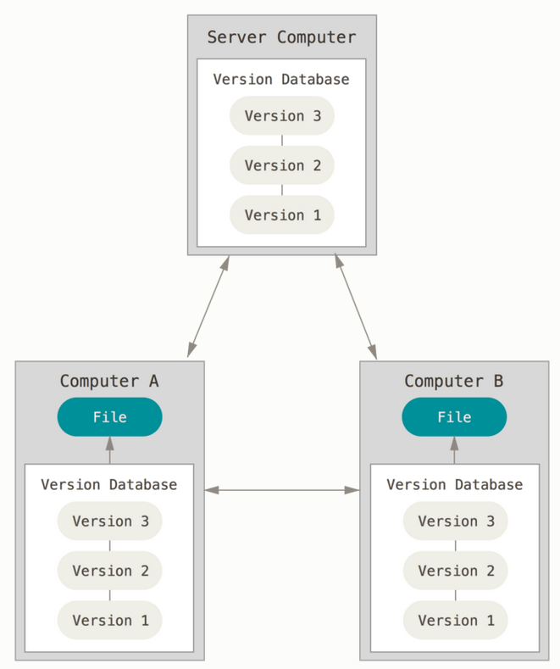
What is git?
Distributed version control
Users keep entire code and history on their location machines
Users can make any changes without internet access
(Except pushing and pulling changes from a remote server)

Slide 5
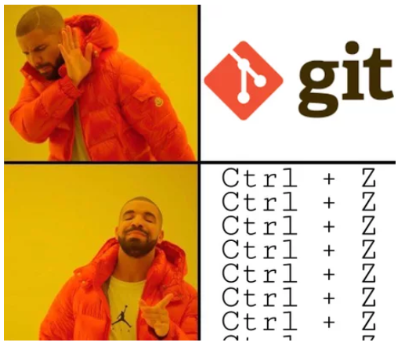
What is version control?
A system that keeps records of your changes
Allows for collaborative development
Allows you to know who made what changes and when
Allows you to revert any changes and go back to a previous state

Slide 6
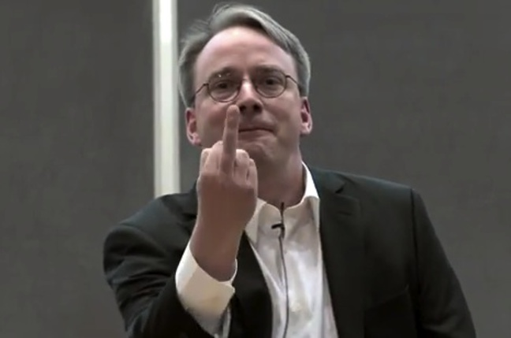

What is git?
Started in 2005
Created by Linus Torvald to aid in Linux kernel development
Notes:
BitKeeper 2002-2005

Slide 7


What is git?
Git isn’t the only version control system

Slide 8
2. How does git work?

Slide 9
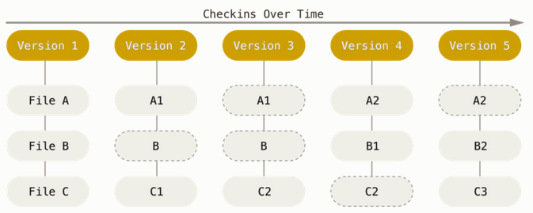
Snapshots, Not Differences
Git thinks about its data more like a stream of snapshots.
With Git, every time you commit, or save the state of your project, Git basically takes a picture of what all your files look like at that moment and stores a reference to that snapshot

Slide 10
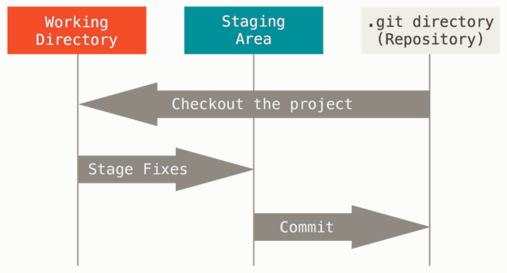
The Three States
Modified – means that you have changed the file but have not committed it to your database yet.
Staged – means that you have marked a modified file in its current version to go into your next commit snapshot.
Committed – means that the data is safely stored in your local database.

Slide 11

Commit
24b9da6552252987aa493b52f8696cd6d3b00373
Essentially, a project is made up of a bunch of commits
Commits contain three pieces of information:
Information about how the ﬁles changed from previously
A reference to the commit that came before it. “parent commit”
A SHA-1 hash looks something like this: fb2d2ec5069fc6776c80b3ad6b7cbde3cade4e

Slide 12
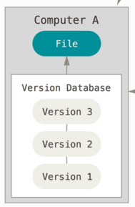
Repositories
You typically obtain a Git repository in one of two ways:
You can take a local directory that is currently not under version control, and turn it into a Git repository, or
You can clone an existing Git repository from elsewhere.
In either case, you end up with a Git repository on your local machine, ready for work.

Slide 13
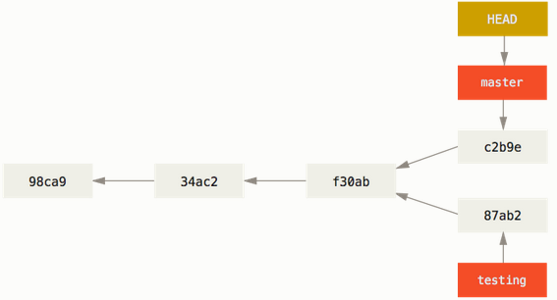
Branching
Branching means you diverge from the main line of development and continue to do work without messing with that main line
All commits in git live on some branch
There can be many, many branches

Slide 14
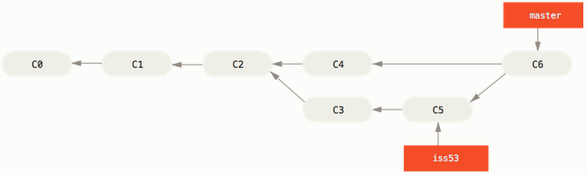
Merging
Git creates a new snapshot that results from this three-way merge and automatically creates a new commit that points to it.
This is referred to as a merge commit, and is special in that it has more than one parent.

Slide 15
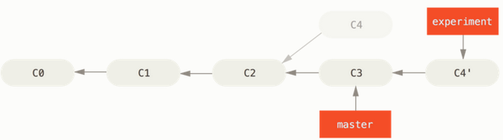
Rebasing
With the rebase command, you can take all the changes that were committed on one branch and replay them on a different branch.

Slide 16
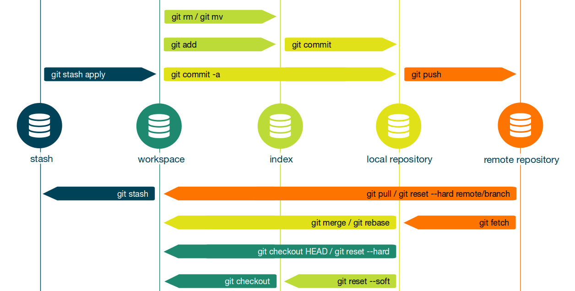
Git workflow

Slide 17
Semantic Commit Messages
feat: (new feature for the user, not a new feature for build script)
fix: (bug fix for the user, not a fix to a build script)
docs: (changes to the documentation)
style: (formatting, missing semi colons, etc; no production code change)
refactor: (refactoring production code, eg. renaming a variable)
test: (adding missing tests, refactoring tests; no production code change)
chore: (updating grunt tasks etc; no production code change)
Semantic Commit Messages

Slide 18
3. Install git and create a GitHub account

Slide 19
Install git
https://git-scm.com/downloads

Slide 20

Create GitHub account
https://github.com/
It’s free!

Slide 21
Git basics

Slide 22
Configure Tooling
git config --global user.name "[name]"
Sets the name you want attached to your commit transactions
git config --global user.email "[email address]"
Sets the email you want attached to your commit transactions

Slide 23
Create Repositories
git init [project-name]
Creates a new local repository with the specified name
git clone [url]
Downloads a project and its entire version history

Slide 24
Make changes
git status
Lists all new or modified files to be committed
git add [file]
Snapshots the file in preparation for versioning
git commit -m "[descriptive message]"
Records the file snapshots permanently in version history

Slide 25
Undoing Things
(old way)
git reset HEAD [file]
Unstages a staged file
git checkout -- [file]
Unmodifies a modified file
(new way)
git restore --staged [file]
– Unstages a staged file
git restore [file]
– Unmodifies a modified file

Slide 26
History
git log
Prints history
git log --pretty=format:"%h %s" --graph
Pretty prints history (there are lots of different ways to format the output)

Slide 27
Group Changes
git branch [branch-name]
Creates a new branch
git checkout [branch-name]/[commit-id]
Switches to the specified branch/commit and updates the working directory

Slide 28
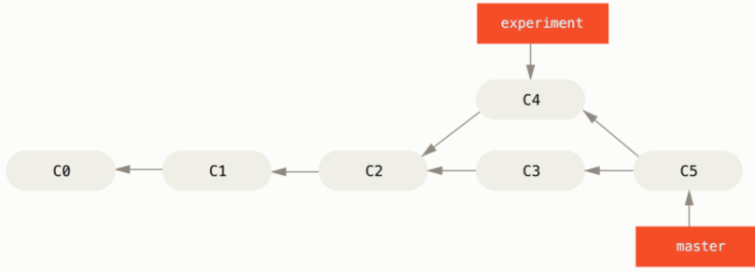
Group Changes
git merge [branch]
Combines the specified branch's history into the current branch

Slide 29
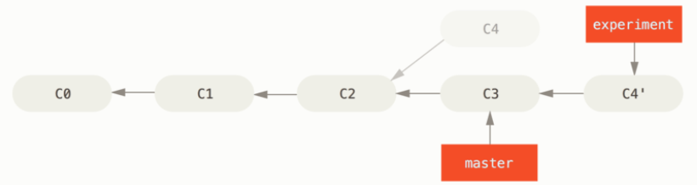
Group Changes
git rebase [branch]
Rebases specified branch's history into the current branch
git rebase --continue
Continue to the next conflict

Slide 30
Remotes
git remote add [remote-name] [url]
Add a new remote git repository as a shortname
git remote -v
Lists all remote git repositories

Slide 31
Synchronize Changes
git push [alias] [branch]
Uploads all local branch commits to remote repo branch
git push -u [alias] [branch]
Sets upstream and uploads all local branch commits to remote repo branch (used only first time pushing a new branch)
git pull
Fetches and merges any commits from the tracking remote branch

Slide 33
Synchronize Changes
git merge [alias]/[branch]
merges a remote branch into your current branch to bring it up to date

Slide 34
Redo commits
git reset [commit]
Undoes all commits after [commit], preserving changes locally
git reset --hard [commit]
Clears staging area, rewrites working tree from specified [commit]

Slide 35
Useful stuff
git config --add --system core.editor notepad
sets notepad as a default editor
git config --global alias.[alias name] ‘[command]’
creates an alias for specified command

Slide 36
.gitignore
.gitignore – file, that tells git which files (or patterns) it should ignore. It's usually used to avoid committing transient files from your working directory that aren't useful to other collaborators, such as compilation products, temporary files IDEs create, etc.

Slide 37
Useful links
https://git-scm.com/book/en/v2
https://stackoverflow.com/
https://www.google.com/

Slide 38
Thank you! Questions?

Slide 39
Practice (part 1)

Slide 40
Task #0
Configure git
set user name
set email
set default text editor

Slide 41
Task #1
Initialize a new git project
Create a new file “readme.txt”
Commit changes to local repo

Slide 42
Task #2
Create a new directory “unwanted”
Create a new directory “important”
Create new files in each directories “file.txt”
Ignore “unwanted” dir
Commit changes to local repo

Slide 43
Task #3
Create a new branch “feature”
Make some changes in that branch
Merge master with branch

Slide 44
Task #4
Create a new branch “conflicts” from master
Create conflicting commits in master and new branch
Merge master with branch (resolve conflict)

Slide 45
Task #4 extra
Create another conflicting commit in master and “conflicts” branch
Rebase master with branch

Slide 46
Task #5
Create a new repository in GitHub
Setup remote in your local git project
Push changes to GitHub

Slide 47
Task #5 extra (write in chat, we’ll try to find you a colleague)
Fork your colleagues GitHub repo
Clone
Create a new branch from “master” in git bash – “collaborate”
Change something
Push it to remote “collaborate” branch
Create a pull request
Ask colleague to review and merge pull request

Slide 48
Practice (part 2)

Slide 49
Task #7 (using Intellij IDE)
Create a new “Hello world!” project in Intellij
Run it!
Init git repo
Ignore compiled files including the directories they’re in
Commit changes

Slide 50
Task #8 (using Intellij IDE)
Create a new branch “feature”
Make some changes in that branch
Merge master with branch

Slide 51
Task #9 (using Intellij IDE)
Create a new branch “conflicts” from master
Create conflicting commits in master and new branch
Rebase master with branch (resolve conflict)

Slide 52
Task #10 (using Intellij IDE)
Share project on GitHub
Create some changes on a new branch
Create a pull request
Merge PR (in the browser)

